Slide 1
Lab 7: Forecasting - Analysis

Slide 2
Station Model Review- Winds
Half barbs are ~5 knots
Full barbs are ~10 barbs
“Flags” are ~50 knots
Station models point in the direction wind is coming FROM

Slide 3
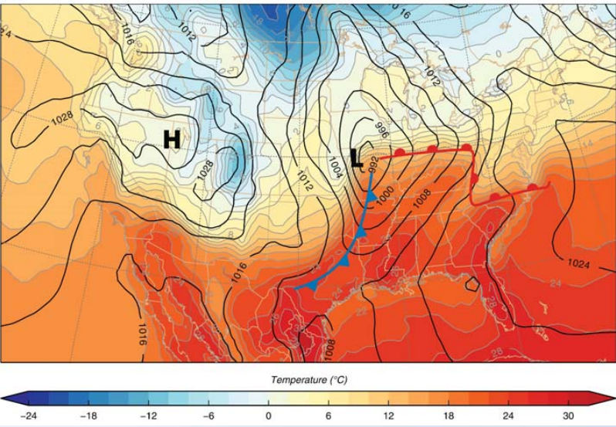
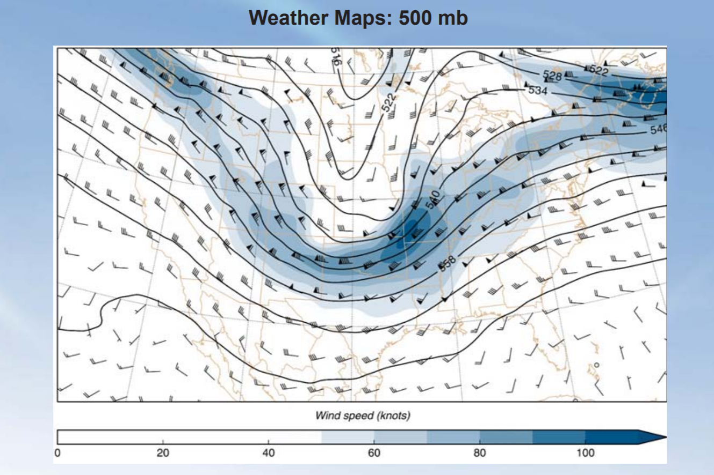
Surface vs Upper Air Maps
High Pressure
Cooler air in front of warm front
Pressure ridge
Low Pressure
warmer air behind warm front and in front of cold front
Pressure trough (notice the surface low pressure is where the upper level trough is)
Cooler air behind cold front

Slide 4
Satellite Imagery: Visible
Visible imagery measures reflected visible radiation (like your cellphone camera)
Thick clouds, like cumulonimbus/thunderclouds, will show up brighter (more white)
Disadvantages:
Cannot see through clouds
Cannot see at night (no reflected sunlight)
https://www.youtube.com/watch?v=IG9sdElyurY&feature=youtu.be

Slide 5
Satellite Imagery: Infrared (IR)
Measures temperature of cloud tops
Brighter colors represent colder cloud tops → we can assume that these clouds are higher in the atmosphere
Can use IR imagery at night
Disadvantage:
Cannot see through clouds
Can be hard to differentiate between clouds that produce thunderstorms and other high clouds (helpful to pair with visible)

Slide 6
Infrared (IR) Imagery Color Varieties

Slide 7
Using both Visible and IR imagery (ideal for Daytime)
C. Mostly bright visible imagery = somewhat thick clouds
C. Not very bright IR imagery = warmer/low cloud tops
A. Bright visible imagery = thick clouds (more solar radiation reflected),
B. Not very bright visible imagery = thin/ wispy clouds
A. Bright IR imagery = cold/higher cloud tops
B. Bright IR imagery = cold/higher cloud tops
C. Likely Stratus
B. Cirrus
A. Cumulonimbus

Slide 8
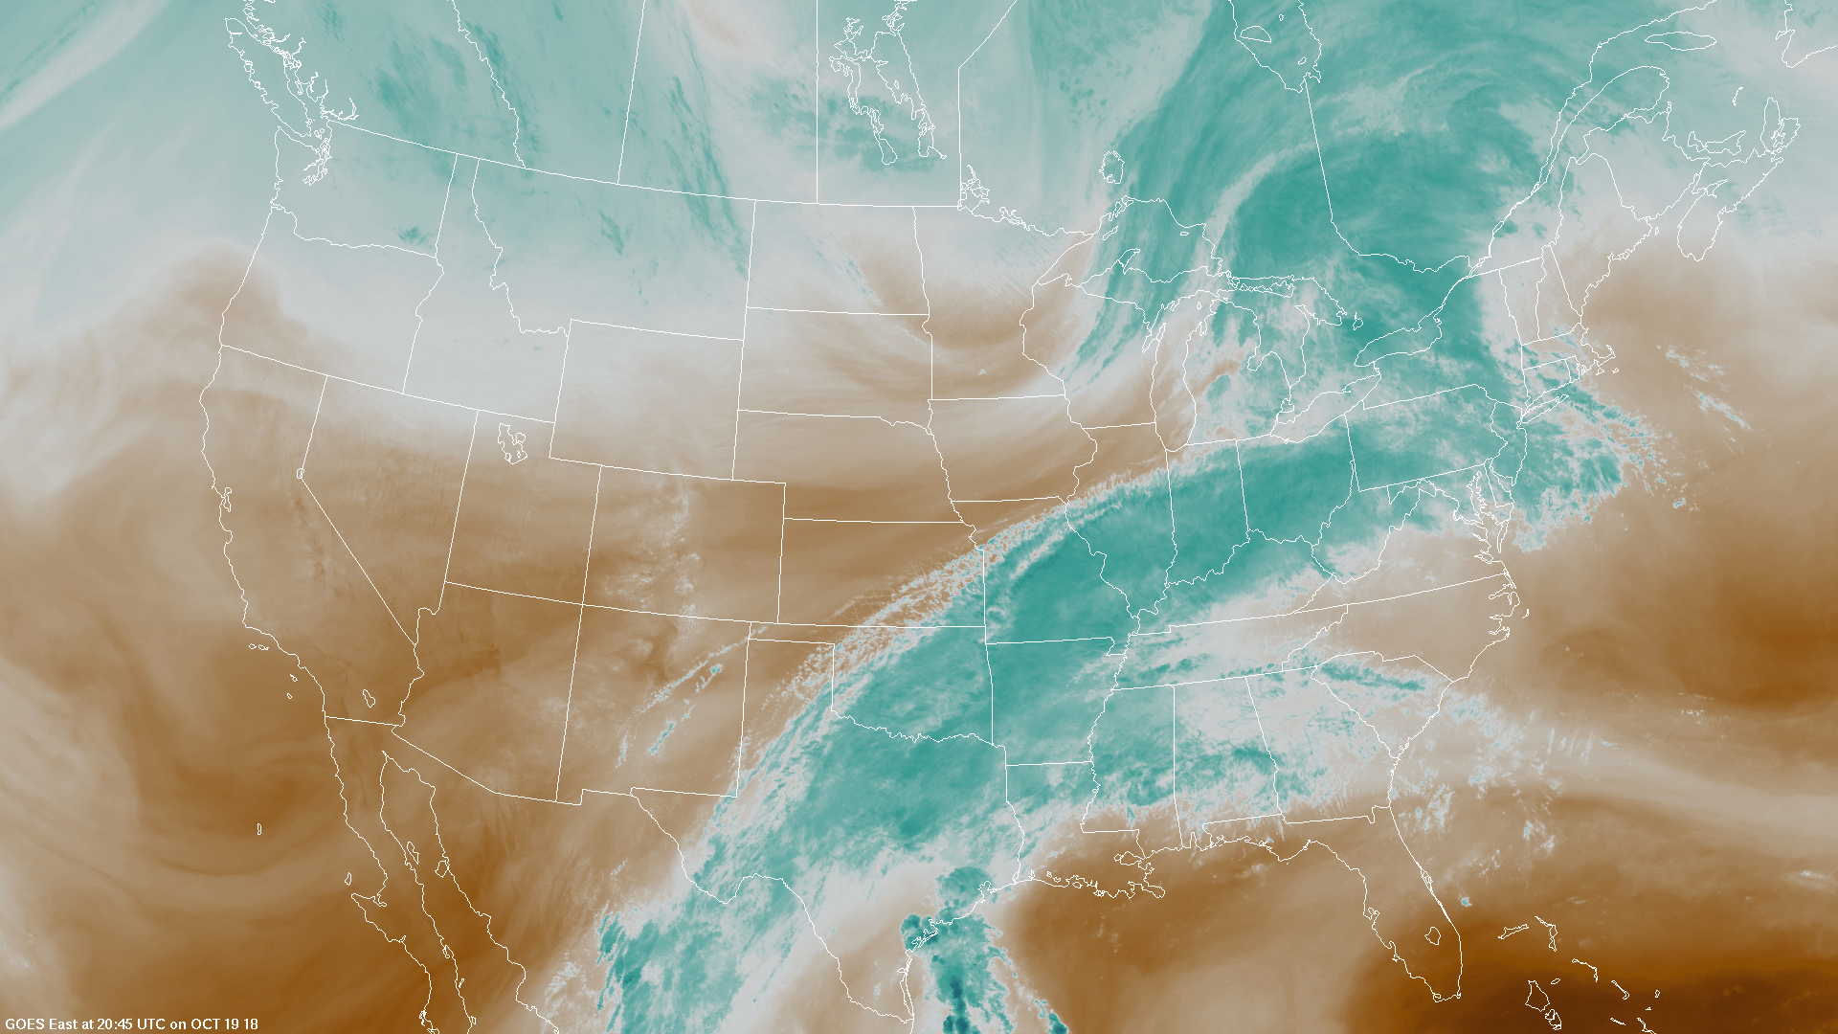
Satellite Imagery: Water Vapor (#5/6)
Not the same date/time
Moist = white (in black/white)
Moist = blue (in false color)
Shows how much water vapor is present in the atmosphere and large scale transport
Can use to see where there are cyclones, anticyclones, and frontal systems
Whiter/bluer colors mean more water vapor is present (interpreted as high absorption by water vapor, or colder temperatures)

Slide 9
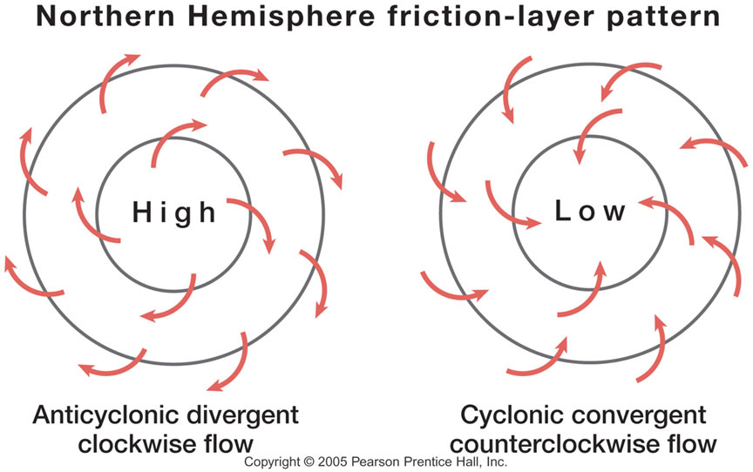
Water Vapor Imagery- moisture transport (#5/6)
We can use this imagery to find upper level cyclones, air mass boundaries (fronts), and convection
Cyclones/anticyclones:
Convection: warm, moist air is buoyant and rising → good indicator of thunderstorms

Slide 10
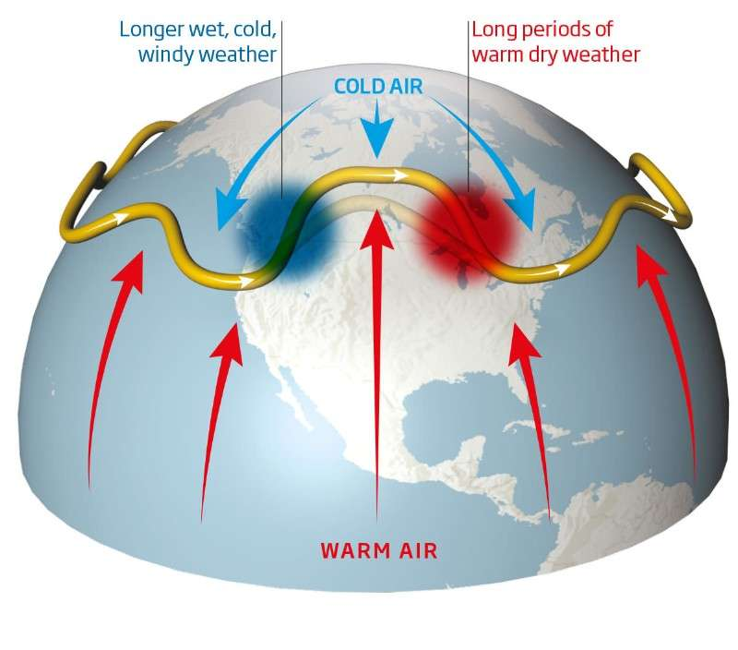
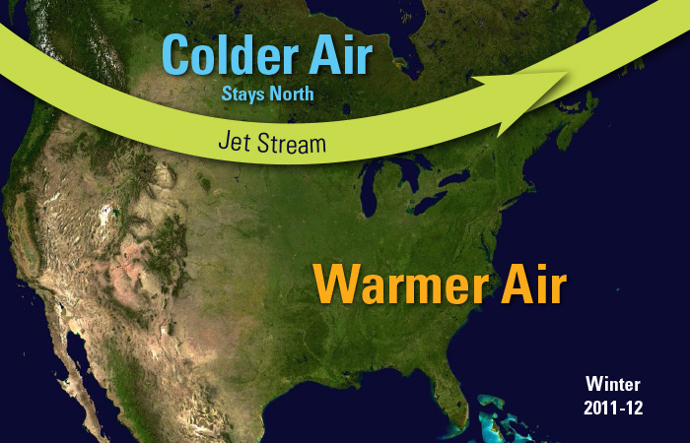
Jet Stream
Forms due to strong horizontal differences in temperature → leads to narrow regions of fast wind speed around the tropopause
Divides cold air to the north from warmer air to the south (Northern hemisphere)

Slide 11
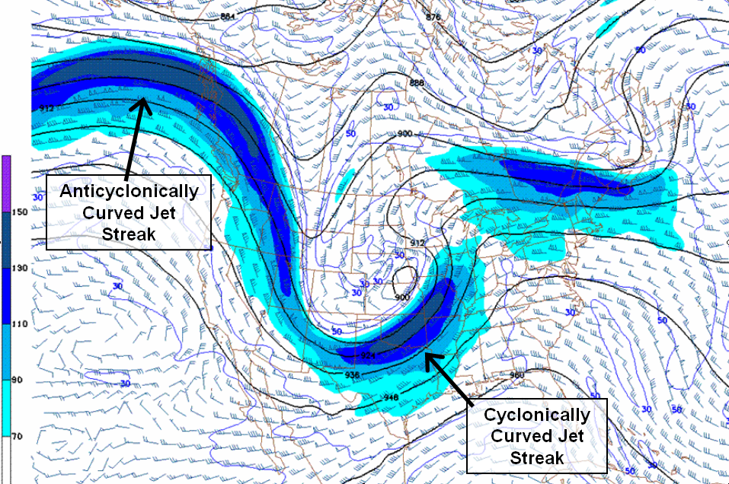
Jet Streaks
Localized areas (within the jet stream) of faster moving winds (like 100 kts)
Play a role in the weather we experience at the surface
These are the basics: if you want to learn more, take atmospheric dynamics!!

Slide 12
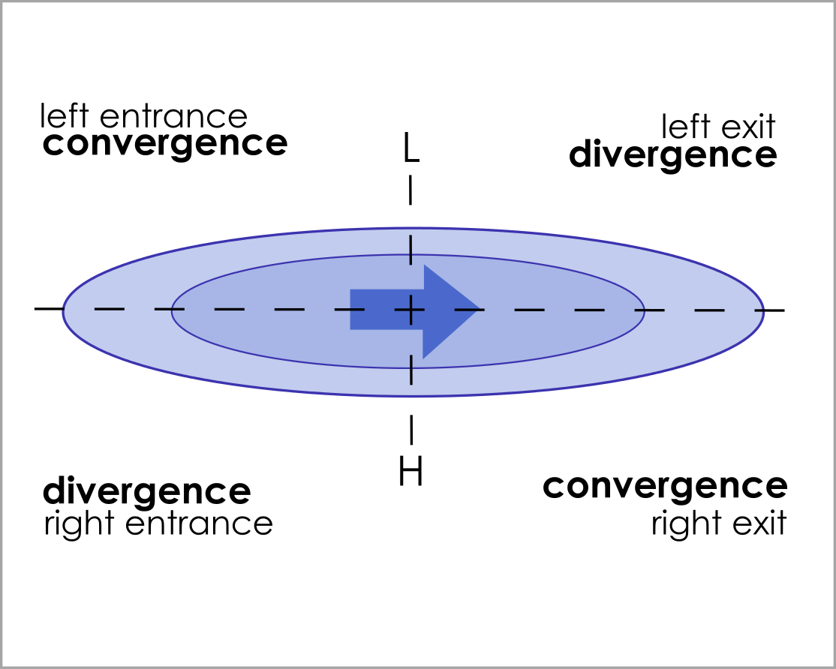
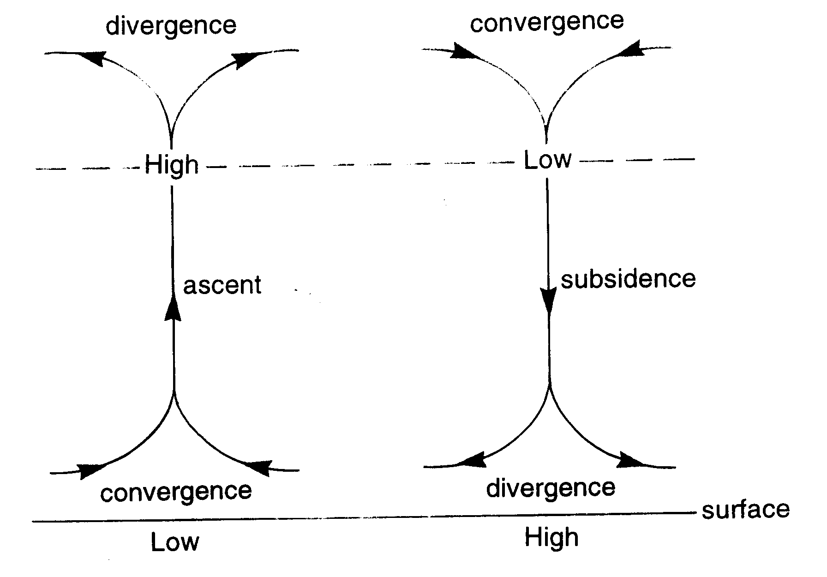
Jet Streaks and Vertical Motion
Jet streaks have four quadrants: left exit (front left), right exit (front right), left entrance (rear left), and right entrance (rear right)
Vertical motion happens in areas of upper left divergence → right entrance and left exit

Slide 13
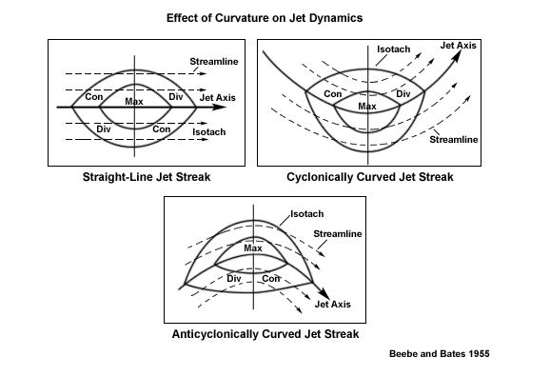
Curved Jet Streaks- Curve enhancement
Quadrants on the inside of a curved jet have enhanced effects
Quadrants outside of a curved jet have a much smaller effect

Slide 14
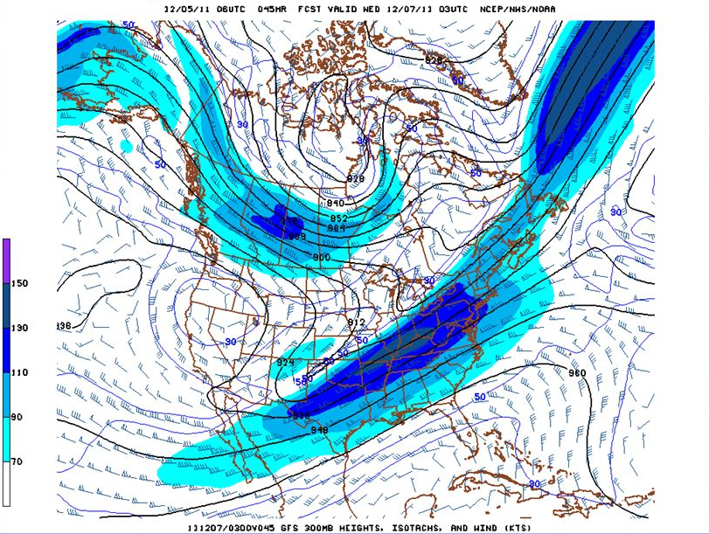
Upper-level divergence examples
Vertical motion in southern Texas, area around Great Lakes, north of Washington state, and central Canada
Enhanced vertical motion in central Canada due to curvature of the jet streak (cyclonic curvature)

